Slide 1

Oxidation and Reduction

Slide 2

Definitions of oxidation and reduction
Oxidation numbers
Redox equations

Slide 3

History of Redox
Oxidation is loss of electrons
Reduction is gain of electrons
  Oxidation is always accompanied by reduction
    The total number of electrons is kept constant
Oxidizing agents oxidize and are themselves reduced
Reducing agents reduce and are themselves oxidized

Slide 4
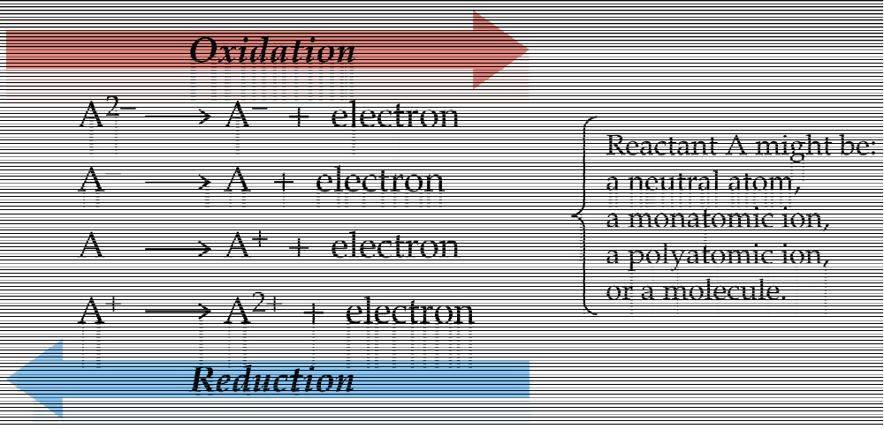


Slide 5

Oxidation number is the number of electrons gained or lost by the element in making a compound
Metals are typically considered more 'cation-like' and would possess positive oxidation numbers,
while nonmetals are considered more 'anion-like' and would possess negative oxidation numbers.

Slide 6
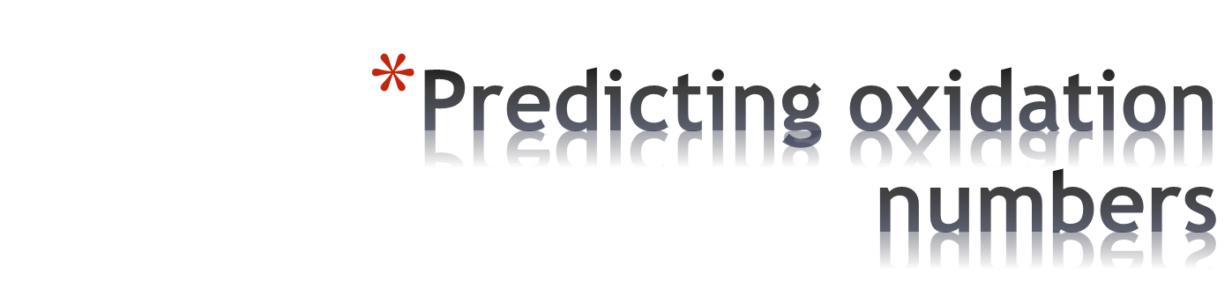
Oxidation number of atoms in element is zero in all cases
The sum of the oxidation numbers in a compound is zero
Oxidation number of element in monatomic ion is equal to the charge
The sum of oxidation numbers in polyatomic ion is equal to the charge
H has oxid no. +1; except in metal hydrides where it is –1
Oxygen is usually –2. Except:
  O is –1 in hydrogen peroxide, H₂O₂ and other peroxides
  O is –1/2 in super-oxides KO₂
  In OF₂ O is +2

Slide 7
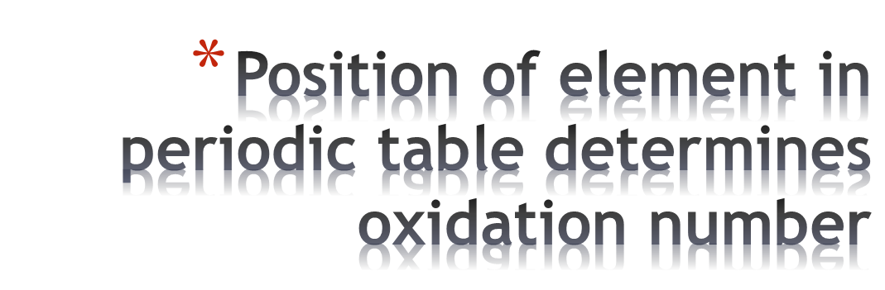
  Group 1 A is +1
  Group 2 A is +2
  Group 13 A is +3 (some rare exceptions)
  Group 15 A are –3 in compounds with metals, H or with NH₄⁺. Exceptions are in compounds to the right; in which case use rules 3 and 4.
  Group 16 A below O are –2 in binary compounds with metals, H or NH₄⁺. When they are combined with O or with a lighter halogen, use rules 3 and 4.
  Group 17 A elements are –1 in binary compounds with metals, H or NH⁴⁺ or with a heavier halogen. When combined with O or a lighter halogen, use rules 3 and 4.

Slide 8

Those elements that tend to give up electrons (metals) are typically categorized as reducing agents and those that tend to accept electrons (nonmetals) are referred to as oxidizing agents.

Slide 9
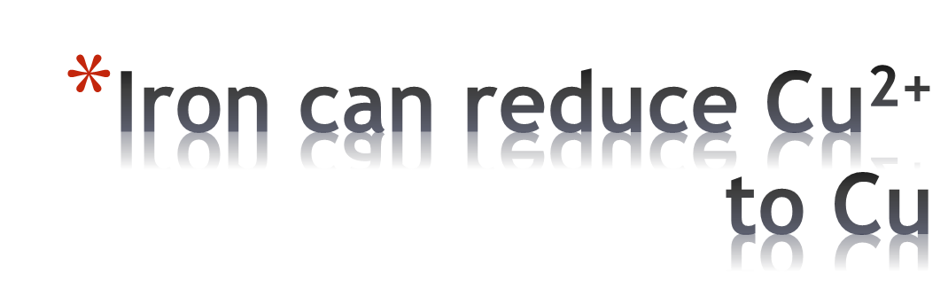
The iron nail reduces the Cu²⁺ ions and becomes coated with metallic Cu. At the same time, the intensity of the blue color diminishes due to loss of Cu²⁺ ions from solution.

Slide 10
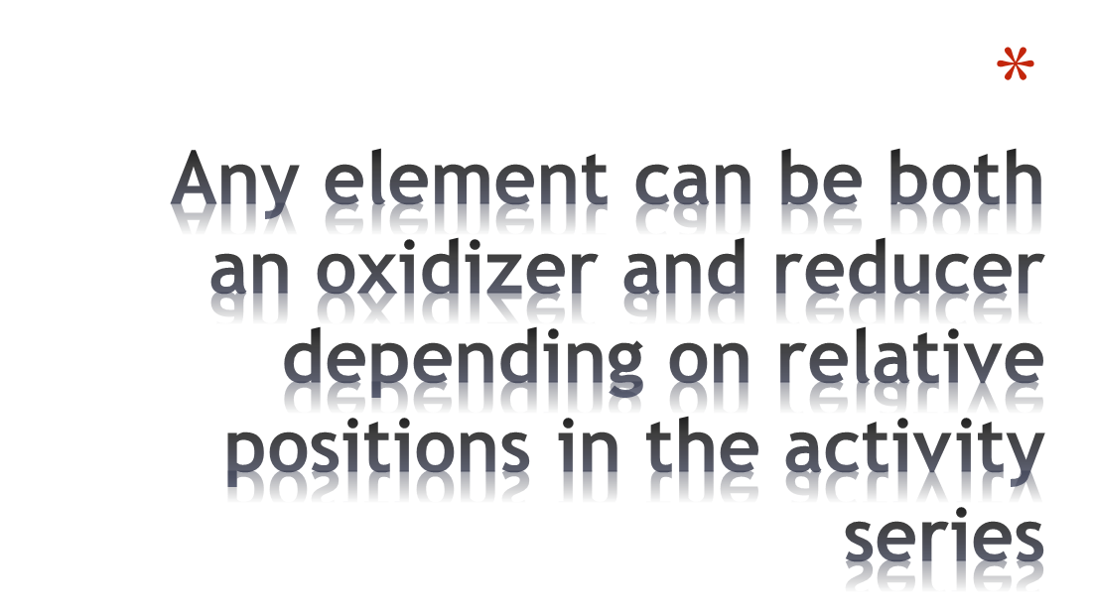
Fe reduced Cu²⁺, but Cu can reduce Ag⁺ (lower activity)
Fe²⁺ is reduced by Zn
Standard reduction tables – data sheet

Slide 11
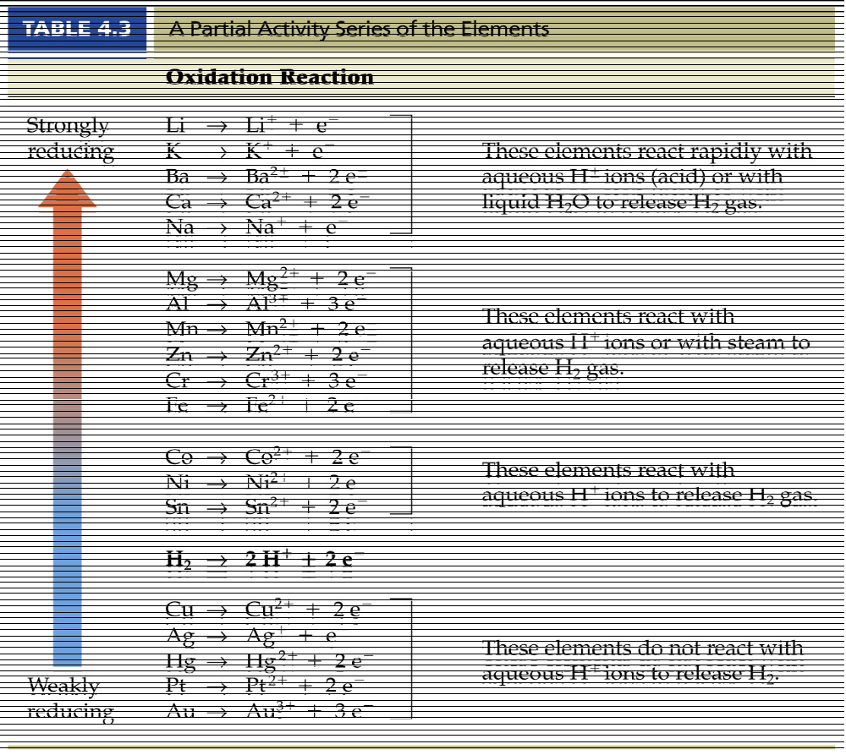
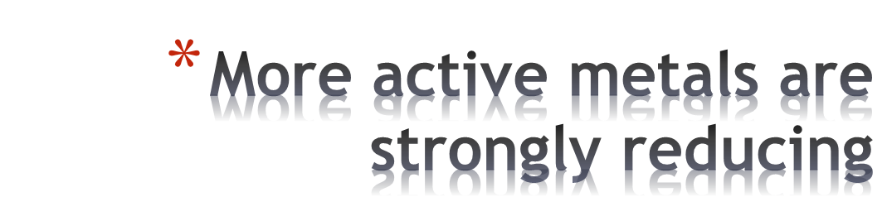

Slide 12

In this reaction the element metal A displaces the ion metal B from its compound
This will only occur if A lies above B in the activity series

Slide 13

Where there is oxidation there is always reduction
Oxidizing agent | Reducing agent
Is itself reduced | Is itself oxidized
Gains electrons | Loses electrons
Causes oxidation | Causes reduction

Slide 14
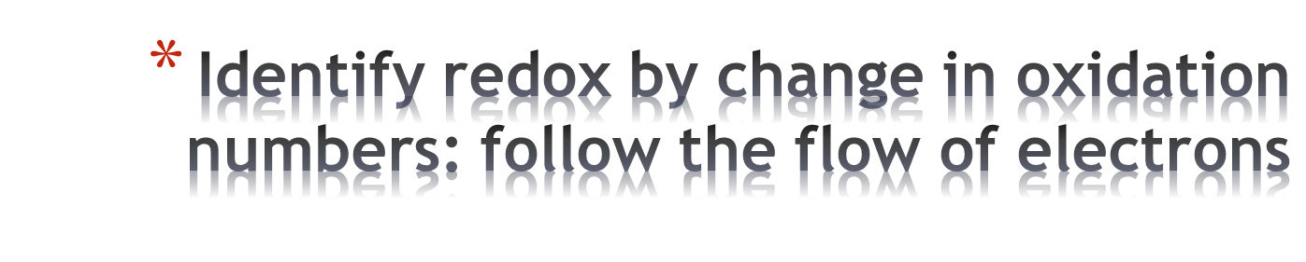
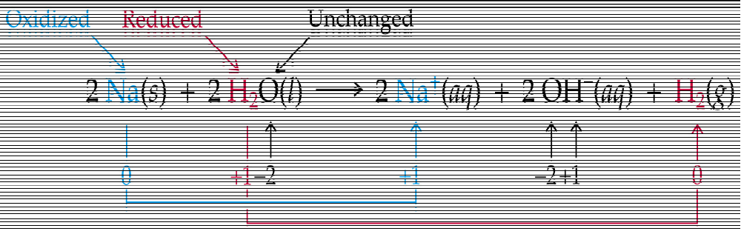
Reducing agent increases its oxidation number
Oxidizing agent decreases its oxidation number

Slide 15
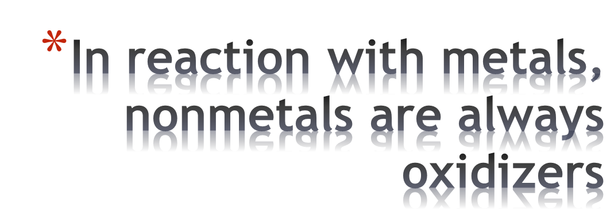
Reactions of elements are always redox
The nonmetal gains electrons, becomes a negative ion
The metal loses electrons, becomes a positive ion
Identification is harder when there are no elements involved: oxidation numbers must be used

Slide 16

Oxidation number method – tracking changes in the oxidation numbers
Half-reaction method – tracking changes in the flow of electrons
Same principles, different emphasis
Use is a matter of choice, but familiarity with both is important

Slide 17
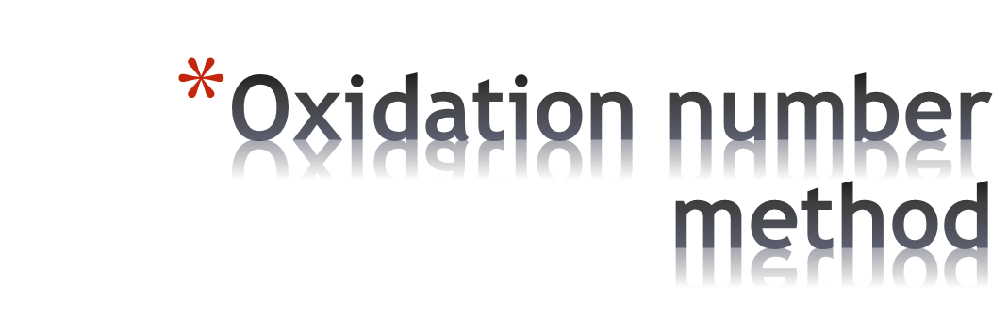
What goes up must come down…
Sum of the changes in oxidation numbers in any process is zero

Slide 18

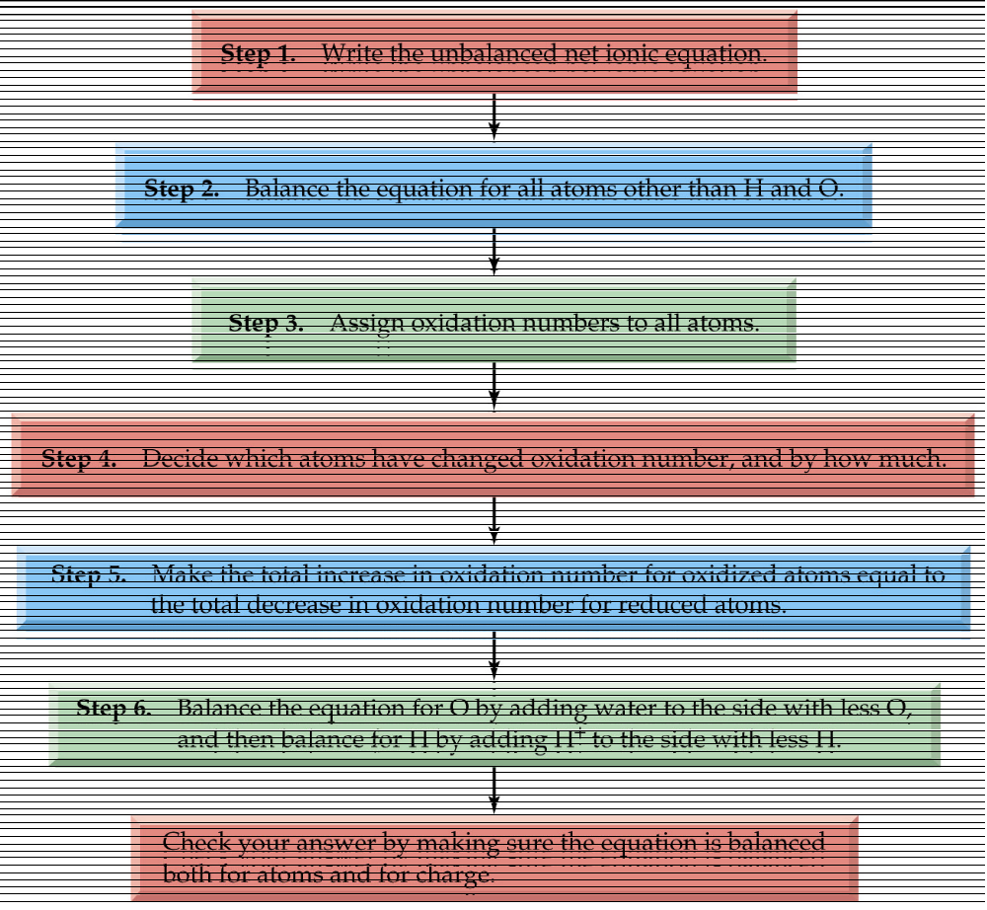

Slide 19

STEP 1: write the unbalanced net ionic equation
In an acid solution, permanganate is reduced by bromide ion to give Mn²⁺ ion and bromine

Slide 20

We need to double the bromide ions on the L.H.S. to balance the equation
*O and H can remain unbalanced because we will top up with water and hydronium ions later

Slide 21

Use the rules of oxidation numbers
Element is zero
Monatomic ion: oxidation number is same as charge
Oxide is -2
+7
-1
+2
0

Slide 22

Mn is reduced from +7 to +2
  Net gain of 5 electrons
Br is oxidized from -1 to 0
  Net loss of 1 electron
+7
-1
+2
0

Slide 23

For every Mn reduced (decrease in oxidation number of 5), need five Br⁻ oxidized (increase in oxidation number of 1)
Equation becomes
Redox is now complete but material balance is not

Slide 24

Strategy: add H₂O to the side that lacks for O and add H⁺ (the reaction is in acid solution) to the other side
In basic solution we add OH⁻ and H₂O instead of H₂O and H⁺ respectively
Test equation for both atoms and charges

Slide 25

Any redox process can be written as the sum of two half reactions: one for the oxidation and one for the reduction

Slide 26

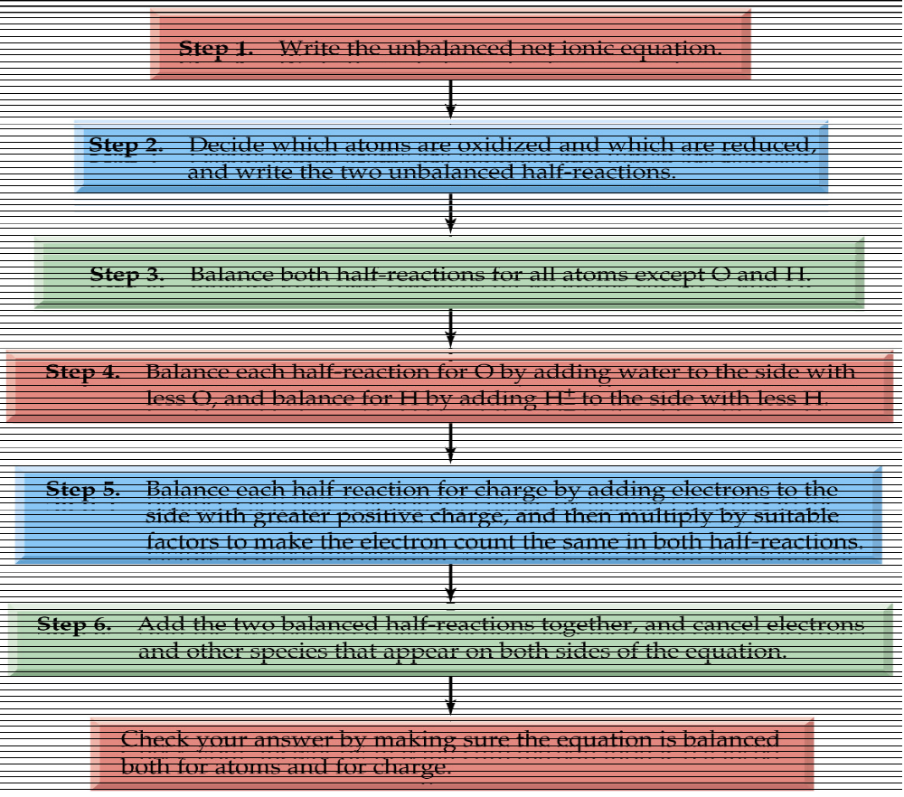

Slide 27

Dichromate ion reacts with chloride ion to produce chlorine and chromium (III)

Slide 28
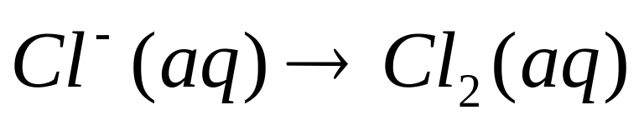
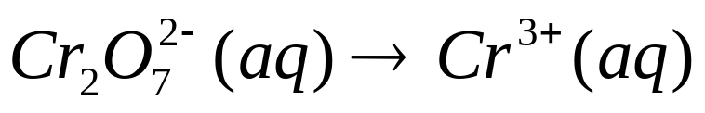
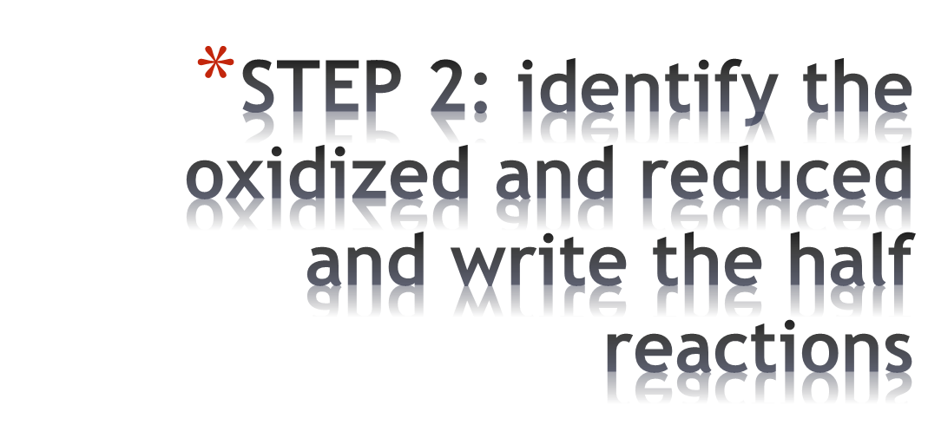
Oxidation half-reaction
Reduction half-reaction

Slide 29
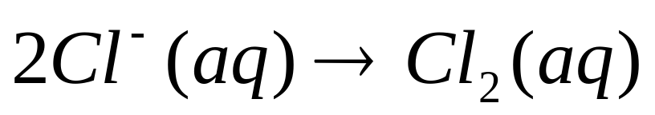
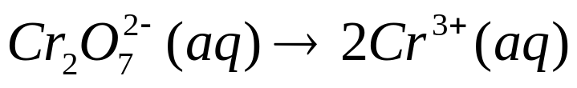

Oxidation
Reduction

Slide 30

As with the oxidation number method, add H₂O to the side lacking O and add H⁺ to the other side (for reactions in acid solution)
Oxidation reaction – unchanged
Reduction reaction

Slide 31
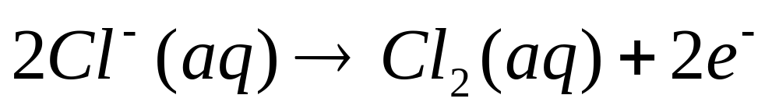
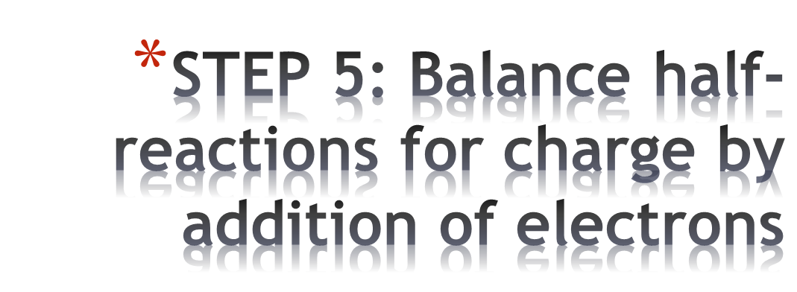
No explicit calculation of oxidation numbers is required; we balance the charges on both sides of each half-reaction

Slide 32
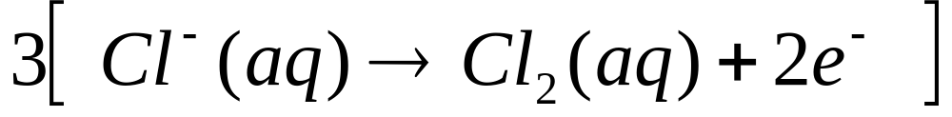
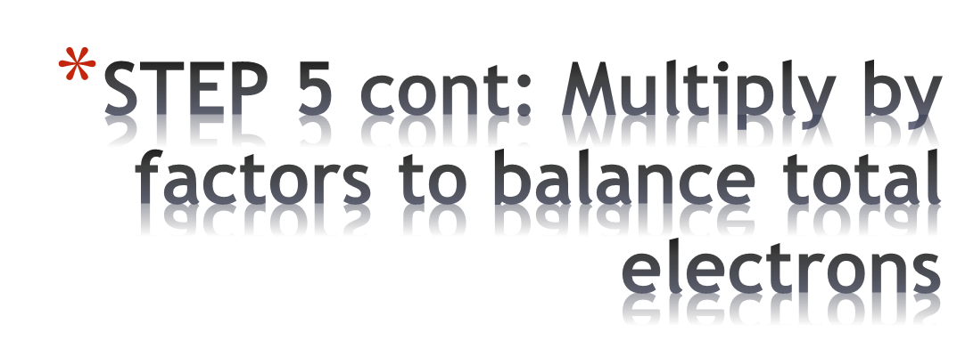
Overall change in electrons must be zero
Multiply the oxidation half reaction by 3

Slide 33
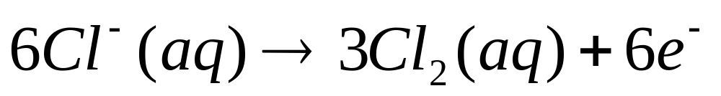
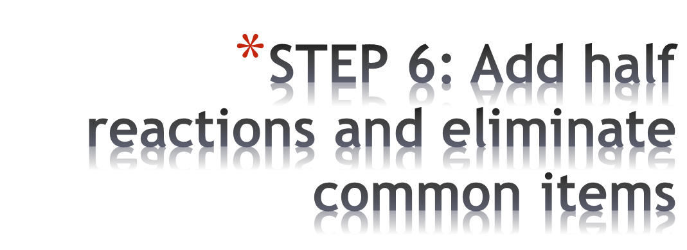
+
=
Atoms and charges balance

Slide 34

For ½ Equations
1. Balance everything except O and H
2. Balance the O by adding water
3. Balance the H by adding H⁺
4. Balance the charge by adding electrons e⁻
^{Check SRT}

Slide 35
Cr₂O₇²⁻ ➔ Cr³⁺
Balance everything except O and H
Cr₂O₇²⁻ ➔ Cr³⁺
Cr₂O₇²⁻ + ➔ 2Cr³⁺
Balance the Oxygen by adding water
Cr₂O₇²⁻ ➔ 2Cr³⁺
Cr₂O₇²⁻ ➔ 2Cr³⁺ + 7H₂O
Balance the Hydrogen atoms by adding H⁺
Cr₂O₇²⁻ ➔ 2Cr³⁺ + 7H₂O
Cr₂O₇²⁻ + 14H⁺ ➔ 2Cr³⁺ + 7H₂O
Balance the charge by adding electrons e⁻
Cr₂O₇²⁻ + + 14H⁺ [12+] ➔ 2Cr³⁺ + 7H₂O [6+]
Cr₂O₇²⁻ + 14H⁺ + 6e⁻ ➔ 2Cr³⁺ + 7H₂O

Slide 36

Balance the e⁻
Cr₂O₇²⁻ + 14H⁺ + 6e⁻ ➔ 2Cr³⁺ + 7H₂O [6]
2Cl⁻ ➔ Cl₂ + 2e⁻ [2] ……. X 3
6Cl⁻ ➔ 3Cl₂ + 6e⁻
Cross out electrons and combine
Cr₂O₇²⁻ + 14H⁺ + 6Cl⁻ ➔ 2Cr³⁺ + 3Cl₂ + 7H₂O

Slide 37

Acid-base titration is used to determine an unknown concentration (either acid or base)
In redox titrations, the concentration of one of the reagents can be measured, provided there is a sharp distinction between the oxidized and reduced states
The endpoint is manifested in a color change (of an indicator) or by measuring pH

Slide 38

Oxalic acid (primary standard) is oxidized by MnO₄⁻
A known quantity of oxalic acid is used to determine the concentration of the MnO₄⁻
MnO₄⁻ has an intense purple colour, whereas Mn²⁺ is almost colourless
So no indicator is needed

Slide 39

A known amount of H₂C₂O₄ is used
A solution of KMnO₄ is titrated till the first purple colour – the endpoint. All the H₂C₂O₄ is oxidized.
The equation gives the number of moles of MnO₄⁻
The volume of solution yields the concentration

Slide 40

Characteristics
1. The electrode where OXIDATION occurs is the ANODE.
2. The electrode where REDUCTION occurs is the CATHODE
3. The electrons move from the ANODE to the CATHODE
4. Negative IONS move from the cathode through the SALT BRIDGE to the anode
5. Positive IONS move from the anode through the SALT BRIDGE to the cathode
6. Under standard conditions the Electromotive Force [EMF] of the cell is equal to the sum of Eº’s of the reaction occurring in the cell
DEFINITION
An electro chemical cell is a device in which an electric current is produced by the action of a redox reaction.
Chemical energy into electrical

Slide 41
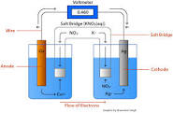

Slide 42
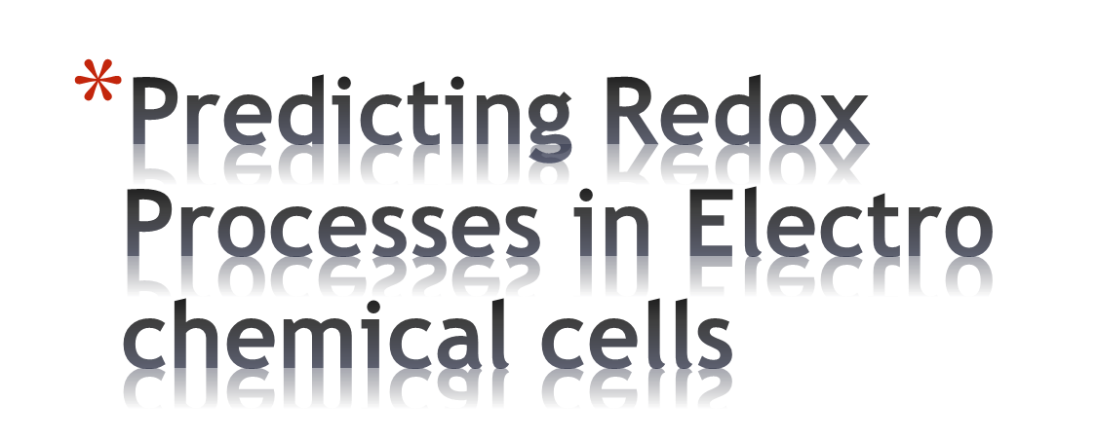
Zinc electrode in a zinc nitrate solution and a tin electrode in tin nitrate solution.
Find
the anode half reaction
the cathode half reaction
the overall redox reaction
The observations, electron and ion flow
The maximum cell EMF under standard conditions

Slide 43

1. Draw cell and list all the reduction species
2. List all the reduction processes and their Eº, select the MOST POSITIVE. – cathode.
3. List all the oxidation species
4. List all the oxid processes and their Eº , select the MOST POSITIVE. – anode
5. Write Redox and ADD Eº’s to get the EMF; use diagram for observations
6. A➔C= electron flow through volt meter ; C➔A through the salt bridge = ion flow

Slide 44

Electrolysis refers to chemical reactions brought about by passing electricity through a molten or aqueous solution.
electrolysis ; electrical energy is converted into chemical energy.
It is really the reverse form of an electrochemical cell

Slide 45

1. the extraction and refining of aluminium, lithium, sodium, potassium, magnesium, zinc and calcium.
2. purification of copper
3. production of sodium hydroxide
4. electroplating of chromium, nickel, tin, zinc or cadmium onto steel
5. plating of silver or gold onto brass
6. anodising
7. recharging batteries

Slide 46

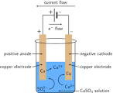

Slide 47

1. Draw cell and list all the reduction species INCLUDING WATER –if aqueous solutions are used
2. List all the reduction processes and their Eº, select the MOST POSITIVE. – cathode.
3. List all the oxidation species
4. List all the oxid processes INCLUDING WATER- if aqueous solutions are used and their Eº , select the MOST POSITIVE. – anode

Slide 48
5. Write Redox and ADD Eº’s to get the EMF; use diagram for observations
6. the electrons flow from A➔C – anode to positive end of the battery then the negative end of the battery to the cathode
7. Anode becomes positively charged/ cathode negatively charged.

